Slide 1
Frequent Structure Mining
Presented By: Ahmed R. Nabhan
Computer Science Department
University of Vermont
Fall 2011
Notes:
ACM SIGKDD 2002 Mohammed Zaki

Slide 2
Copyright Note:
This presentation is based on the paper:
Zaki MJ: Efficiently mining frequent trees in a forest. In proceedings of the 8th ACM SIGKDD International Conference Knowledge Discovery and Data Mining, 2002.
The original presentation made by author has been used to produce this presentation

Slide 3
Outline
Graph pattern mining - overview
Mining Complex Structures - Introduction
Motivation and Contributions of author
Problem Definition and Case Examples
Main Ingredients for Efficient Pattern Extraction
Experimental Results
Conclusions

Slide 4
Outline
Graph pattern mining – overview
Mining Complex (Sub-)Structures - Introduction
Motivation and Contributions of author
Problem Definition and Case Examples
Main Ingredients for Efficient Pattern Extraction
Experimental Results
Conclusions

Slide 5
Graph pattern mining - overview
Graphs are convenient data structures that can represent many complex entities
They come in many flavors: undirected, directed, labeled, unlabeled.
We are drowning in graph data:
  Social networks
  Biological networks (genetic pathways, PPI networks)
  WWW
  XML documents

Slide 6
Some Graph Mining Problems
Pattern Discovery
Graph Clustering
Graph classification and label propagation
Evolving graphs present interesting problems regarding structure and dynamics

Slide 7
Graph Mining Framework
Mining graph patterns is a fundamental problem in graph data mining
Exploratory Task
Clustering
mine
select
Classification
Relevant Patterns
Graph Dataset
Structure Indexes
Exponential Pattern Space

Slide 8
Basic Concepts
Graph. A graph g is a three-tuple g = (V, E, L), where
V is the finite set of nodes,
E ⊆ V x V is the set of edges, and
L is labeling function for edges and nodes
SubGraph. Let g₁ = (V₁,E₁,L₁) and g₂ = (V₂, E₂,L₂). g1 is subgraph of g2, written g1 ⊆ g2, if
1) V₁ ⊆ V₂,
2) E₁⊆ E₁,
3) L₁ (v) = L₂ (v), for all v ∈ V₁ and
4) L₁ (e) = L₂ (e) for all e ∈ E₁

Slide 9
Basic Concepts (Cont.)
Graph Isomorphism. Let g₁ = (V₁,E₁,L₁) and g₂ = (V₂, E₂,L₂). A graph isomorphism is a bijective function
f: V₁ → V₂ satisfying
1) L₁(u) = L₂(f(u)) for all nodes u ∈ V₁ ,
2) For each e₁ = (u,v) ∈ E₁, there exists an edge
e₂(f(u), f(v)) ∈ E₂ such that L₁(e₁) = L₂(e₂)
3) For each e₂ = (u,v) ∈ E₂, there exists an edge
e₁(f⁻¹(u), f⁻¹(v)) ∈ E₁ such that L₁(e₁) = L₂(e₂)

Slide 10
Basic Concepts (Cont.)
G1=(V1,E1,L1)
G2=(V2,E2,L2)
f(V1.I) = V2.1
f(V1.II) = V2.2
f(V1.III) = V2.3
f(V1.IV) = V2.4
f(V1.V) = V2.5
5
4
III
I
V
G2
3
II
IV
2
1
(a)
(b)
(c)
Two Isomorphic graph (a) and (b) with their mapping function (c)
Subgraph isomorphism is even more challenging!
Subgraph isomorphism is NP-Complete

Slide 11
Discovering Subgraphs
Subgraph or substructure pattern mining are key concepts in TreeMiner and gSpan (next presentation)
Testing for graph or subgraph isomorphism is a way to measure similarity between to substructures (it is like the testing for equality operator ‘==‘ in programming langs)
There are exponential number of subgraph patterns inside a larger graph
Finding frequent subgraphs (or subtrees) tends to be useful in graph data mining

Slide 12
Outline
Graph pattern mining – overview
Mining Complex Structures - Introduction
Motivation and Contributions
Problem Definition and Case Examples
Main Ingredients for Efficient Pattern Extraction
Experimental Results
Conclusions

Slide 13
Mining Complex Structures
Frequent Structure Mining tasks:
  Item sets (transactional, unordered data)
  Sequences (temporal/positional: text, bioseqs)
  Tree patterns (semi-structured/XML data, web mining, bioinformatics, etc.)
  Graph patterns (bioinformatics, web data)
“Frequent” used broadly:
  Maximal or closed patterns in dense data
  Correlation, other statistical metrics
  Interesting, rare, non-redundant patterns

Slide 14
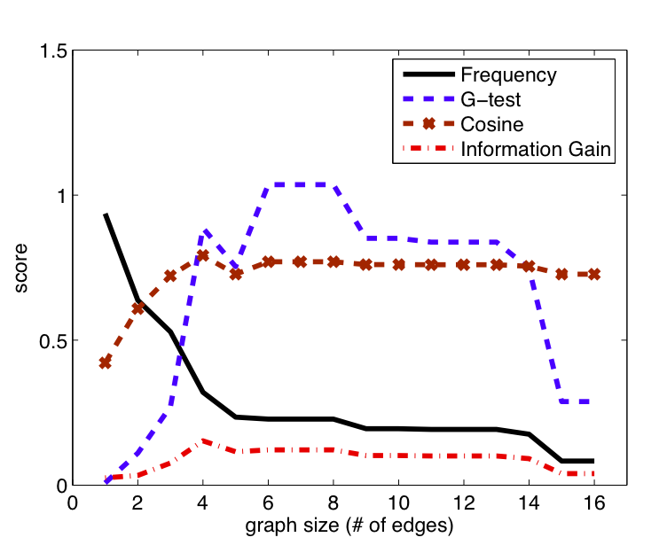
Anti-Monotonicity
The frequency of a super-pattern is less than or equal to the frequency of a sub-pattern. Copyright SIGMOD’08

Slide 15
Outline
Graph pattern mining – overview
Mining Complex Structures - Introduction
Motivation and Contributions
Problem Definition and Case Examples
Main Ingredients for Efficient Pattern Extraction
Experimental Results
Conclusions

Slide 16
Tree Mining: Motivation
Capture intricate (subspace) patterns
Can be used (as features) to build global models (classification, clustering, etc.)
Ideally suited for categorical, high-dimensional, complex and massive data
Interesting Applications
  XML, semi-structured data: Mine structure + content for Classification
  Web usage mining: Log mining (user sessions as trees)
  Bioinformatics: RNA sub-structures, phylogenetic trees

Slide 17
Classification example
Subgraph patterns can be used as features for classification
… | 1 | … | … | … | 1 | … | …
Hexagons are popular subgraph in chemical compounds
Then, off-the-shelf classifiers, like NN classifiers can be trained using this vectors
Feature selection is an exciting problem too!

Slide 18
Contributions
Mining embedded subtrees in rooted, ordered, and labeled trees (forest) or a single large tree
Notion of node scope
Representing trees as strings
Scope-lists for subtree occurrences
Systematic subtree enumeration
Extensions for mining unlabeled or unordered subtrees or sub-forests

Slide 19
Outline
Graph pattern mining – overview
Mining Complex Structures - Introduction
Motivation and Contributions
Problem Definition and Case Examples
Main Ingredients for Efficient Pattern Extraction
Experimental Results
Conclusions

Slide 20
How searching for patterns works?
Start with graphs with small sizes (number of nodes)
Then, extends k-sizes graphs by one node to generate k+ 1 candidate patterns
A scoring function is used to evaluate each candidate
A popular scoring function is a one that defines the minimum support. Only graphs with frequency greater than the min_sup value are kept for output
support (g) >= min_sup

Slide 21
How searching for patterns works? (cont.)
Quote: “the generation of size (k+1) sub-graph candidates from size k frequent subgraphs is more complicated and costly than that of itemsets” (Yan & Han 2002, gSpan)
Where to add a new edge?
One may add an edge to a pattern and then find that this pattern does not exist in the dataset!
The main story of this presentation is about good candidate generation strategies

Slide 22
How TreeMiner works?
The author used a technique for numbering tree nodes based on DFS
Using this numbering to encode subtrees as vectors
Subtrees sharing a common prefix (say the first k numbers in vectors) form an equivalence class
Generate new candidates (k+1)-subtrees from equivalence classes of k-subtrees (We are familiar with this Apriori-based extension)
So what is the point?

Slide 23
How TreeMiner works?(cont.)
The point is candidate subtrees are generated only once!
(remember the subgraph isomorphism problem that makes it likely to generate the same pattern over and over!)

Slide 24
Tree Mining: Definitions
Rooted tree: special node called root
Ordered tree: child order matters
Labeled tree: nodes have labels
Ancestor (embedded child): x ≤_{l} y (l length path x to y)
Sibling nodes: two nodes having same parent
Embedded siblings: two nodes having common ancestor
Depth-first Numbering: node’s position in a pre-order traversal of the tree
A node has a number n_{i} and a label l(n_{i})
Scope of node n_{l} is [l, r], n_{r} is rightmost leaf under n_{l}

Slide 25
Ancestors and Siblings
A
A
A is the common ancestor of B and D
B
C
B
C
C
Siblings
Embedded Siblings
D
E

Slide 26
Tree Mining: Definitions
Embedded Subtrees: S = (N_{s}, B_{s}) is a subtree of
T = (N,B) if and only if (iff)
  N_{s} ⊆ N
  b = (n_{x}, n_{y}) ∊ B_{s} iff n_{x} ≤_{l} n_{y} in T (n_{x} ancestor of n_{y})
  Note: in an induced subtree b = (n_{x}, n_{y}) ∊ B_{s}
  iff (n_{x}, n_{y}) ∊ B (n_{x} is parent of n_{y})
  We say S occurs in T if S is a subtree of T
  If S has k nodes, we call it a k-subtree
Able to extract patterns hidden (embedded) deep within large trees; missed by traditional definition of induced subtrees

Slide 27
Tree Mining Problem
Match labels of S in T
  Positions in T where each node of S matches
  Match label is unique for each occurrence of S in T
Support: Subtree may occur more than once in a tree in D, but count it only once
Weighted Support: Count each occurrence of a subtree (e.g., useful when |D| =1)
Given a database (forest) D of trees, find all frequent embedded subtrees
  Should occur in a minimum number of times
  used-defined minimum support (minsup)

Slide 28
Subtree Example
Scope: 1 is the DFS number of the node, and 5 is the DFS code for right most node in subtree rooted at node 1
Subtree
Tree
1
[0,6]
Match Labels:
0
1
134
n0
135
1
2
1
2
[6,6]
[1,5]
n1
n6
3
2
[2,4]
5
[5,5]
n2
n5
1
2
[3,3]
[4,4]
3
n3
n4
Support = 1
Weighted Support = 2
4

Slide 29
Example sub-forest (not a subtree)
By definition a subtree is connected
A disconnected pattern is a sub-forest
Tree
Sub-forest
0
1
0
n0
1
2
3
2
n1
n6
3
2
1
n2
n5
1
2
n3
n4

Slide 30
Outline
Graph pattern mining – overview
Mining Complex (Sub-)Structures - Introduction
Motivation and Contributions
Problem Definition and Case Examples
Main Ingredients for Efficient Pattern Extraction
Experimental Results
Conclusions

Slide 31
Tree Mining: Main Ingredients
Pattern representation
  Trees as strings
Candidate generation
  No duplicates
Pattern counting
  Scope-list based (TreeMiner)
  Pattern matching based (PatternMatcher)

Slide 32
String Representation of Trees
0
0
1
3
1
-1
2
-1
-1
2
-1
-1
2
-1
1
2
With N nodes, M branches, F max fanout
Adjacency Matrix requires: N(F+1) space
Adjacency List requires: 4N-2 space
Tree requires (node, child, sibling): 3N space
String representation requires: 2N-1 space
3
2
1
2

Slide 33
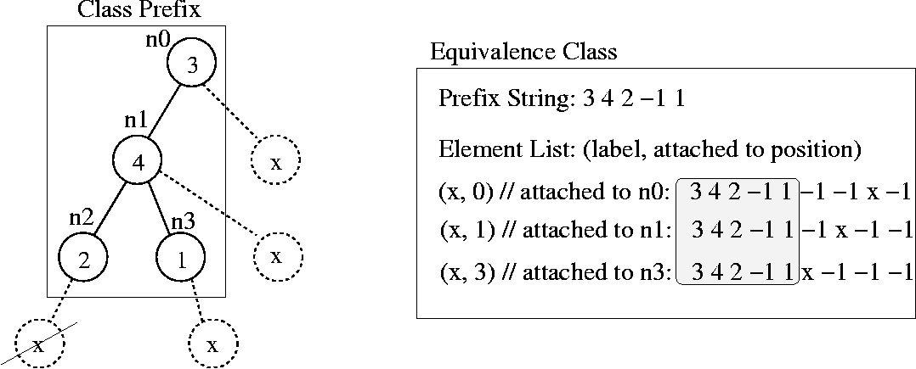
Systematic Candidate Generation: Equivalence Classes
Two subtrees are in the same class iff they share a common prefix
string P up to the (k-1)th node
A valid element x attached to only the nodes lying on the path from
root to rightmost leaf in prefix P
Not valid position: Prefix 3 4 2 x (invalid prefix ➔ different class!)

Slide 34
Candidate Generation
Generate new candidates (k+1)-subtrees from equivalence classes of k-subtrees
Consider each pair of elements in a class, including self-extensions
Up to two new candidates from each pair of joined elements
All possible candidates subtrees are enumerated
Each subtree is generated only once!

Slide 35
Candidate Generation (illustrated)
Each class is represented in memory by a prefix (a substring of the numberized vector) and a set of ordered pairs indicating nodes that exist in this class
A class is extending by applying a join operator ⊗ on all ordered pairs in the class

Slide 36
Candidate Generation (illustrated)
Equivalence Class
Prefix: 1 2
Elements: (3,1) (4,0)
1
1
2
2
4
3
(4,0) means a node labeled ‘4’ is attached to a node numbered 0 according to DFS. Do not confuse DFS numbers with node labels!

Slide 37
Theorem 1(Class Extension)
It defines a join operator ⊗ on the two elements, denoted (x,i)⊗(y,j), as follows:
case I – (i=j):
a) If P != ∅, add (y,j) and (y,j +1) to class [Px]
b) If P = ∅, add (y, j + 1) to [Px]
case II – (i > j): add (y,j) to class [Px].
case III – (i < j): no new candidate is possible in this case.

Slide 38
Class Extension: Example
Consider prefix class P = (1 2), which contains 2 elements, (3, 1) and (4, 0)
When we self-join (3,1)⊗(3,1) case I applies
This produces candidate elements (3, 1) and (3, 2) for the new class P3 = (1 2 3)
When we join (3,1)⊗(4,0) case II applies
The following figure illustrate the self-join process

Slide 39
Class Extension: Example with Figure
DFS numbering of nodes
1
1
0
1
1
0
⊗
=
1
2
2
1
2
2
3
3
2
3
3
3
3
A class with prefix {1,2} contains a node with label 3. This is written as: (3,1), meaning a node labeled ‘3’ is added at position 1 in DFS order of nodes.
A new class with prefix {1,2,3} is formed. The elements in this class are (3,2),(3,1) → node labeled ‘3’ can be attached to nodes # 2 & # 3 according to DFS numbering

Slide 40
Candidate Generation (Join operator ⊗)
Self Join
New Candidates
Equivalence Class
Prefix: 1 2, Elements: (3,1) (4,0)
1
1
1
1
1
1
1
2
⊗
2
2
2
2
4
3
3
2
2
4
3
3
3
3
Join
1
1
3
3
⊗
“The main idea is to consider each ordered pair of elements in the class for extension, including self extension.”
2
2
4
New Equivalence Class
Prefix: 1 2 3
Elements: (3,1) (3,2) (4,0)
3

Slide 41
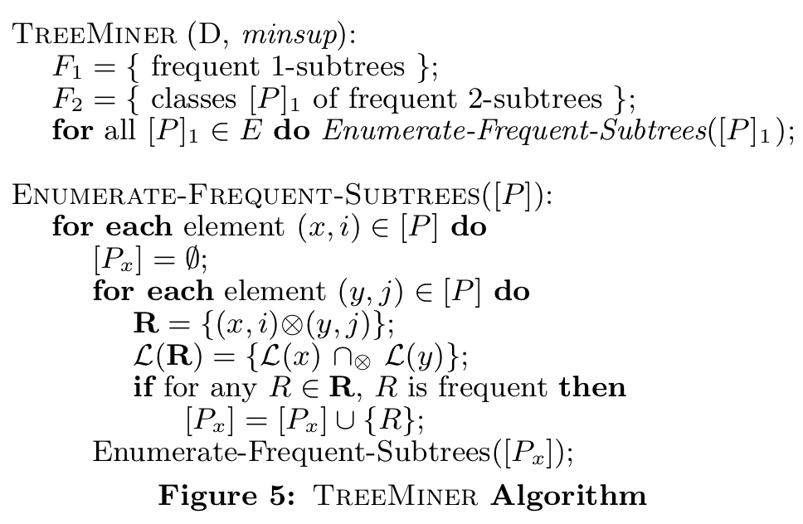
TreeMiner outline
Candidate generation
⊗ operator is a key element
Scoring function that uses Scope Lists of nodes

Slide 42
ScopeList Join
ScopeLists are used to calculate support
Join of ScopeLists of nodes is based on interval algebra
Let s_{x} = [l_{x},u_{x}] be a scope for node x, and s_{y} = [l_{y},u_{y}] a scope for y.
We say that s_{x} contains s_{y} ,denoted
s_{x} ⊃ s_{y}, iff l_{x} ≤ l_{y} and u_{x} ≥u_{y}

Slide 43
TreeMiner:Scope List for Trees
String Representation
T0: 1 2 -1 3 4 -1 -1
T1: 2 1 2 -1 4 -1 -1 2 -1 3 -1
T2: 1 3 2 -1 -1 5 1 2 -1 3 4 -1 -1 -1 -1
T0
1
[0,3]
T2
1
[0,7]
[1,1]
2
3
[2,3]
3
5
[3,7]
[1,2]
Scope-Lists
Tree id
4
[3,3]
2
1
[4,7]
1
2
3
4
[2,2]
[6,7]
2
3
0, [0,3]
0, [1,1]
1, [0,5]
1, [2,2]
1, [4,4]
2, [2,2]
2, [5,5]
0, [2,3]
1, [5,5]
2, [1,2]
2, [6,7]
0,[3,3]
1,[3,3]
2,[7,7]
[0,5]
[5,5]
1, [1,3]
T1
2
4
2, [0,7]
2, [4,7]
[7,7]
[1,3]
1
2
3
[4,4]
[5,5]
5
2
4
With support = 50%, node labeled 5 will be excluded and no further expansion for it will take place
2, [3,7]
[2,2]
[3,3]

Slide 44
Outline
Graph pattern mining – overview
Mining Complex Structures - Introduction
Motivation and Contributions
Problem Definition and Case Examples
Main Ingredients for Efficient Pattern Extraction
Experimental Results
Conclusions

Slide 45
Experimental Results
Machine: 500Mhz PentiumII, 512MB memory, 9GB disk, Linux 6.0
Synthetic Data: Web browsing
  Parameters: N = #Labels, M = #Nodes,
  F = Max Fanout, D = Max Depth, T = #Trees
  Create master website tree W
    For each node in W, generate #children (0 to F)
    Assign probabilities of following each child or to backtrack; adding up to 1
    Recursively continue until D is reached
  Generate a database of T subtrees of W
    Start at root. Recursively at each node generate a random number
    (0-1) to decide which child to follow or to backtrack.
  Default parameters: N=100, M=10,000, D=10, F=10, T=100,000
  Three Datasets: D10 (all default values), F5 (F=5), T1M (T=10⁶)
Real Data: CSLOGS – 1 month web log files at RPI CS
  Over 13361 pages accessed (#labels)
  Obtained 59,691 user browsing trees (#number of trees)
  Average string length of 23.3 per tree

Slide 46
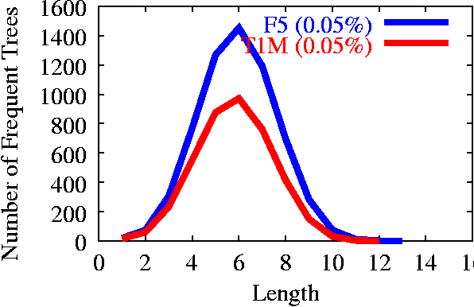
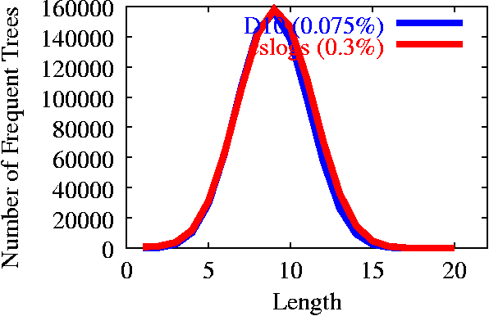
Distribution of Frequent Trees
Sparse
Dense

Slide 47
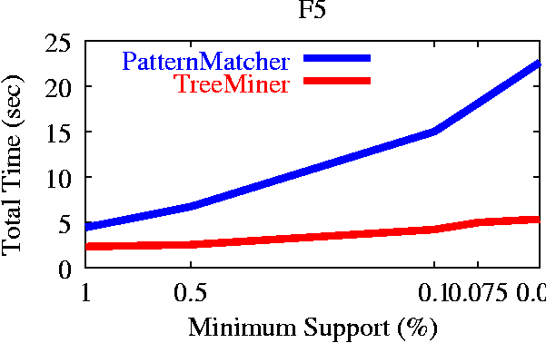
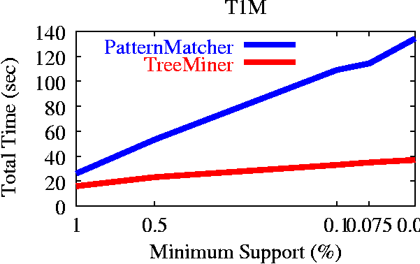
Experiments (Sparse)
Relatively short patterns in sparse data
Level-wise approach able to cope with it
TreeMiner about 4 times faster

Slide 48
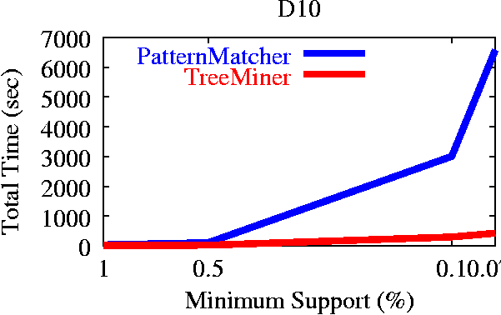
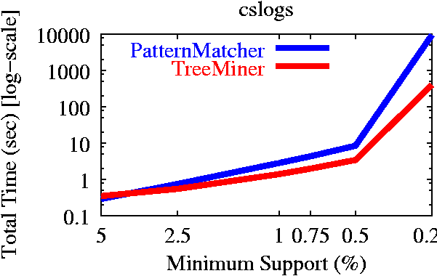
Experiments (Dense)
Long patterns at low support (length=20)
Level-wise approach suffers
TreeMiner 20 times faster!

Slide 49
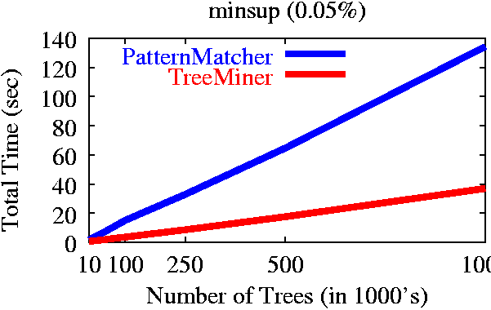
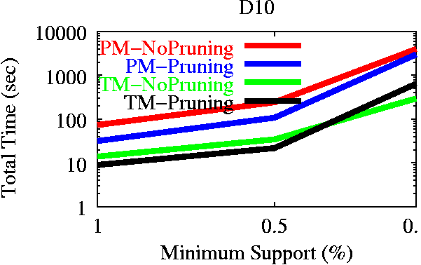
Scaleup

Slide 50
Outline
Graph pattern mining – overview
Mining Complex (Sub-)Structures - Introduction
Motivation and Contributions
Problem Definition and Case Examples
Main Ingredients for Efficient Pattern Extraction
Experimental Results
Conclusions

Slide 51
Conclusions
TreeMiner: Novel tree mining approach
  Non-duplicate candidate generation
  Scope-list joins for frequency computation
Framework for Tree Mining Tasks
  Frequent subtrees in a forest of rooted, labeled, ordered trees
  Frequent subtrees in a single tree
  Unlabeled or unordered trees
  Frequent Sub-forests
Outperforms pattern matching approach
Future Work: constraints, maximal subtrees, inexact label matching

Slide 52
Post Script: Frequent does not always mean significant!
Exhaustive enumeration is a problem, despite the fact that candidate generation in TreeMiner is efficient and does not generate a candidate structure more than once
Using low min_sup values to avoid missing important structures, but likely to produce redundant/irrelevant ones
State-of-the-art graph structure miners make use of the structure of the search space (e.g. LEAP search algorithm) to extract only significant structures

Slide 53
Post Script: Frequent does not mean always significant (cont)
There are many criteria to evaluate candidate structures. Tan et al. (2002)¹ summarized about 21 interestingness measures including: mutual information, Odds ratio, Jaccard, cosine ….
A key idea in searching pattern space is that to discover relevant/significant patterns earlier in the search space than later!
Structure mining can be coupled with other data mining tasks such as classification by mining only discriminative features (substructures)
¹Tan PN, Kumar V, Srivastava J. Selecting the right interestingness measure for association patterns; 2002. ACM. pp. 32-41.

Slide 54
Questions
Q1- describe some applications for mining frequent structures
Answer: Frequent structure mining can be a basic step in some graph mining tasks such as graph structure indexing, clustering, classification and label propagation
Q2- Name some advantages and disadvantages of TreeMiner algorithms.
Answer: Advantages include: avoiding generation of duplicate pattern candidates, efficient method for frequency calculation using scope lists, and novel tree encoding method that can be used to test isomorphism efficiently.

Slide 55
Questions (cont.)
Disadvantages of TreeMiner include: enumerating all possible patterns. State-of-the-art methods use strategies that only explore significant patterns. Also, it uses frequency as the only scoring function of patterns, but frequency does not necessarily mean significant or discriminative.

Slide 56
Questions (cont.)
Q3- Why frequency of subgraphs is a good function that is used to evaluate candidate patterns?
Answer: Because frequency of subgraphs is anti-monotonic function, which means that super-graphs are not more frequent than subgraphs. This is a desirable property for searching algorithms to make the search stop (using min_sup threshold) as candidate subgraph patterns get bigger and bigger, because frequency of super-graphs tend to decrease.

